Slide 1
Session 5
Wonderful Wider World

Slide 2
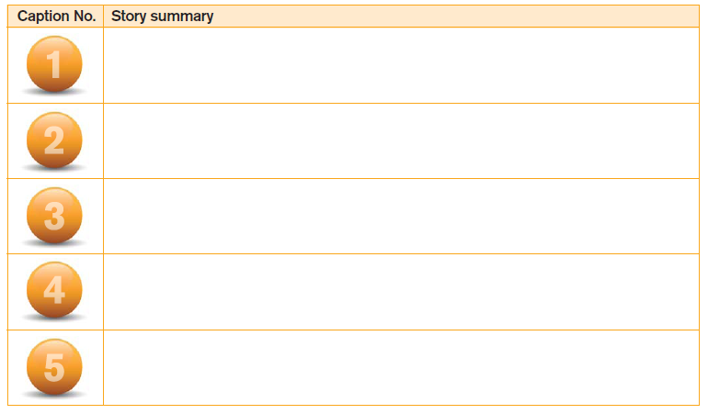
Complete the missing words in the news headline.

Slide 3
1

Slide 4
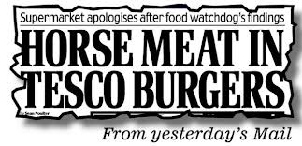
2

Slide 5
3

Slide 6
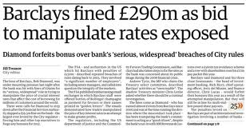
4

Slide 7
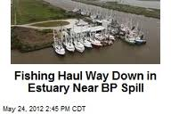
5

Slide 8
Examiners Tip
QWC
When a question is asterisked (*) this means the marker will be looking for Quality of Written Communication (QWC). You need to check your answers for spelling and grammar. Use well developed sentences and paragraphs.

Slide 9
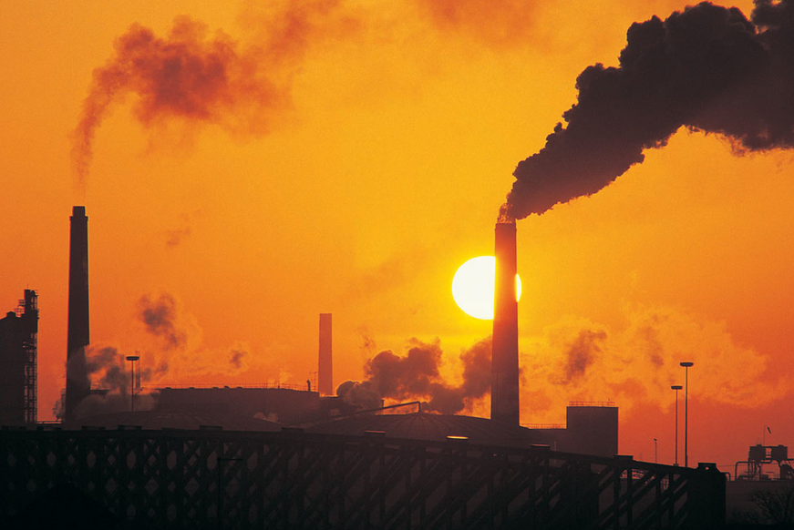
Ethical and Environmental issue

Slide 10
What do we mean by business ethics?
Ethical behaviour is doing what is morally right

Slide 11
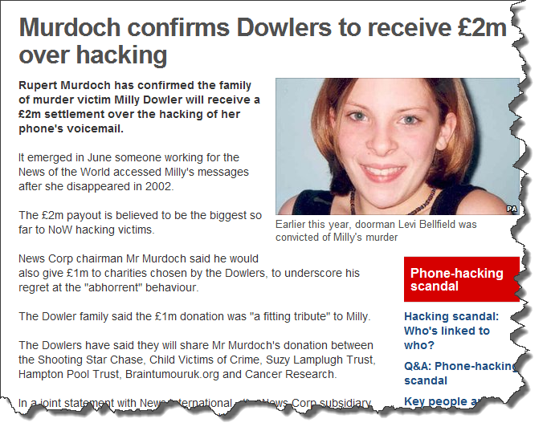
An example of bad business ethics

Slide 12
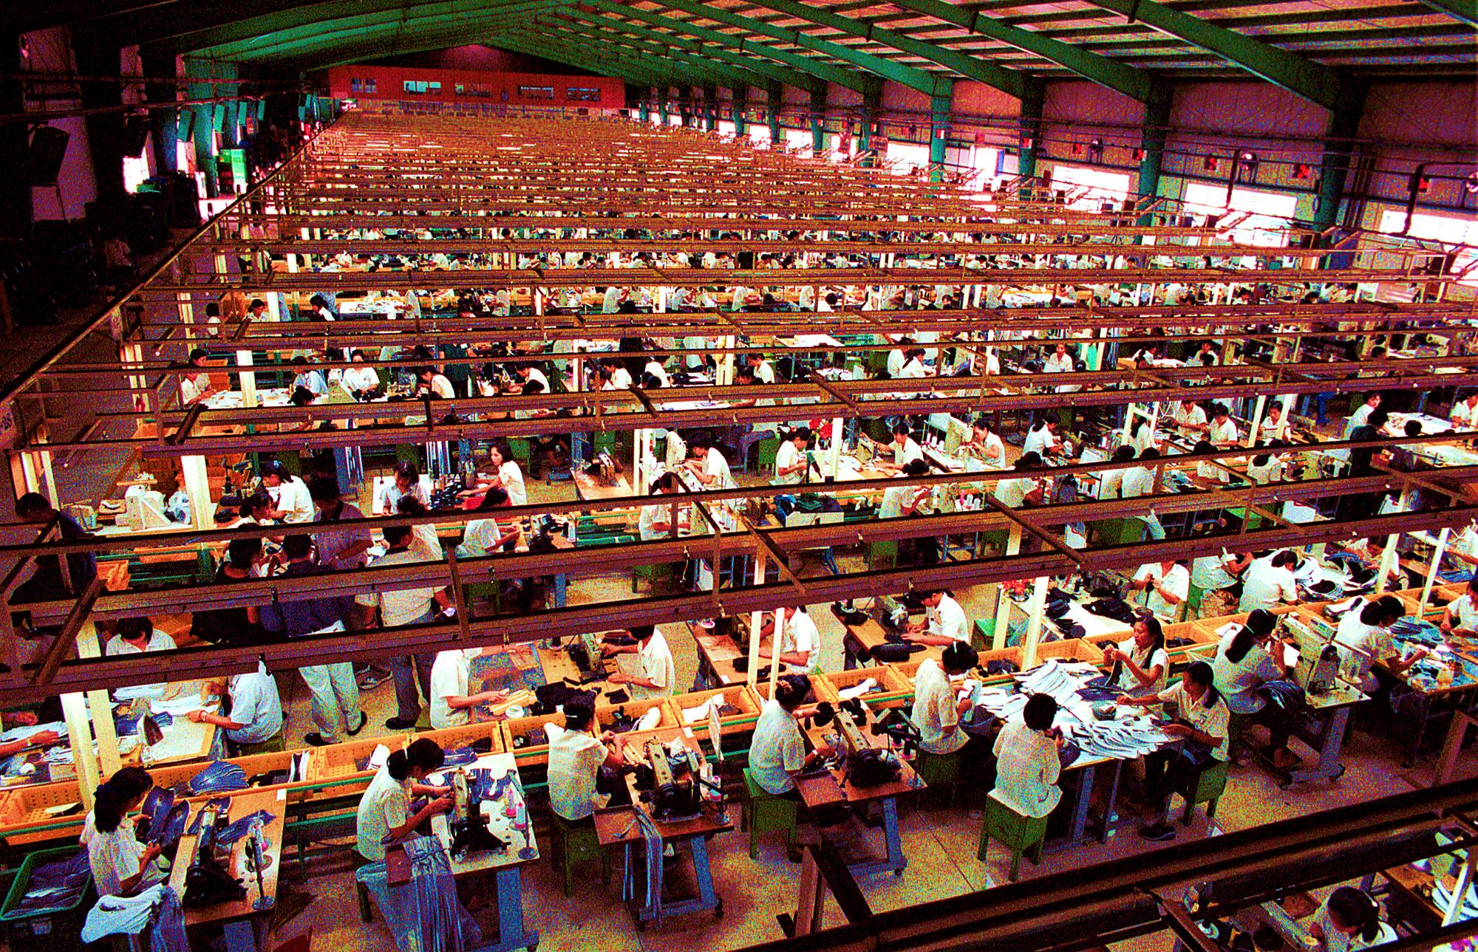
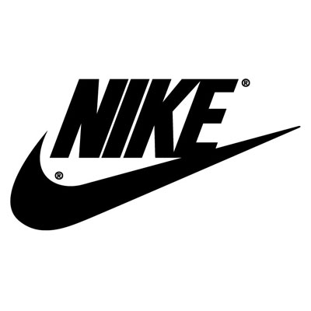
Brands that have been caught out using child labour or sweatshops

Slide 13
Watch the video clip and let’s consider the ethical issues facing businesses

Slide 14
Explain one advantage and one disadvantage to Nike of using cheap labour in Asian countries to make its sportswear (8 marks)

Slide 15
Explain one advantage and one disadvantage to Nike of using cheap labour in Asian countries to make its sportswear (8 marks)
Advantage
Disadvantage
Reduces cost of production
Bad publicity
As a result, the contribution per unit would increase. This would lead to Nike making more profit which could be used to finance the research and development in to new innovative products
This could mean that customers become aware of the way in which products are made. Therefore they may choose not to buy their products in protest. In turn this would lead to lower sales revenue and a fall in profitability.

Slide 16
Examiners Tip
Discuss
The focus for ‘discuss’ questions is showing your ability to present a balanced discussion. You will only be able to access limited marks if you only present one side of the argument

Slide 17
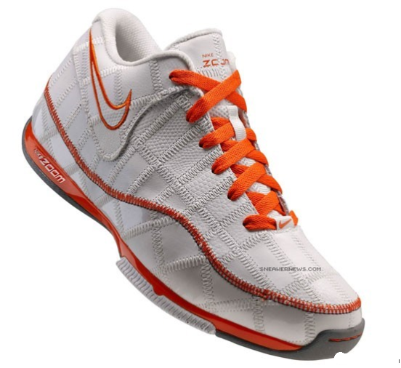
Exam Style Question
To what extent will the Trash Talk trainer help Nike develop a reputation
as a business with strong ethical values?

Slide 18
To what extent will the Trash Talk trainer help Nike develop a reputation as a business with strong ethical values?
State and explain one argument FOR this helping Nike’s reputation (Girls) | State and explain one argument AGAINST this necessarily helping Nike’s reputation (Boys)

Slide 19
To what extent will the Trash Talk trainer help Nike develop a reputation as a business with strong ethical values?
State and explain one argument FOR this helping Nike’s reputation (Girls)
By developing this trainer, Nike will gain a reputation as a firm that manufactures in an environmentally friendly way. As a result they may gain new customers who like to ensure they buy from ethical companies. This could lead to these consumers recommending the product, and Nike, to other consumers interested in ethical firms.

Slide 20
To what extent will the Trash Talk trainer help Nike develop a reputation as a business with strong ethical values?
 | State and explain one argument AGAINST this necessarily helping Nike’s reputation (Boys)
Because Nike has been associated with sweatshops in the past consumers may view this as a publicity stunt. It could mean that pressure groups look more closely at other aspects of what Nike do. As a result new ethical issues in Nike’s operations could be revealed that damage the business’ reputation.

Slide 21
To what extent will the Trash Talk trainer help Nike develop a reputation as a business with strong ethical values?
Conclusion that answers the question | I believe..

Slide 22
Economic issues affecting trade
Read through the case study and have a go at answering the quick questions

Slide 23
Quick questions
What is a subsidy?
What is a tariff?
What is a quota?
A government measure that reduces the price of goods sold abroad by providing financial support to exporting businesses.
Taxes put on goods imported into a country to make them more expensive buyers so that goods made by home businesses are more competitive.
A limit on the number of goods that can be imported in to a country in a given period of time so that businesses based in that country do not lose sales due to high levels of competition from imports.

Slide 24
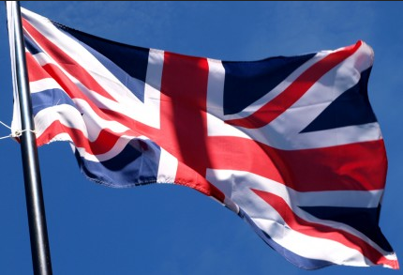
How will the following affect British businesses?
A subsidy paid by a foreign government on products made overseas and imported into the UK
A tariff imposed by a foreign government on products imported into their country by a British business
A quota that limits the number of products a British business can import into a foreign country

Slide 25
How will the following affect British businesses?
A subsidy paid by a foreign government on products made overseas and imported into the UK
The foreign goods will become cheaper to buy in the UK.
This might mean that consumers buy more foreign products and less British products – impacting on the revenue of British businesses

Slide 26
How will the following affect British businesses?
A tariff imposed by a foreign government on products imported into their country by a British business
This will make the British goods more expensive in the foreign country. Consumers in foreign countries will buy less British goods if their prices increase compared to the non-British goods.

Slide 27
How will the following affect British businesses?
A quota that limits the number of products a British business can import into a foreign country
Limiting the number of products will limit the opportunity for British businesses to make profits.

Slide 28
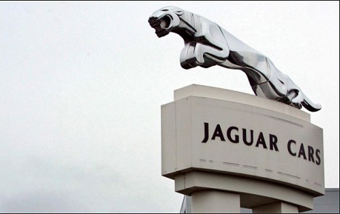
Brazil’s government recently announced an increase to the import tariffs it will charge foreign manufacturers of luxury cars. The news came as a blow to JaguarLandRover who is seeking to develop its sales in this market.
Using your knowledge of business, discuss the extent to which the
decision of the Brazil government will severely damage JaguarLandRover’s profits.

Slide 29
Discuss the extent to which the decision of the Brazil government will severely damage JaguarLandRover’s profits.
An import tariff is a measure used by the Brazilian government that adds a tax on to cars imported in to Brazil to try and make cars made in Brazil more price competitive to support their economy.
This could damage JLR’s profits by making their cars more expensive in Brazil compared to rivals. As a result they will not sell as many and this will reduce their sales revenues and their profits.
However, Jaguar’s cars are desirable luxury ones, so on the other hand it may well be that the sorts of people that will buy them will not be put off be the extra price that is added by the import tariff.
Overall I do not believe the tariff is likely to severely damage profits since Jaguar does not currently sell lots of cars in Brazil anyway. The extent to which it does damage profits will depend upon how many sales Jaguar sell in Brazil already and just how big the import tariff is.

